Slide 1
Autistica Challenge
Team 21
Lalitha Priya Bhupalam | Mehdi Naderi Varandi | Yavor Edipov | James Craster | Oluwafemi Oladipo | Iurii Maksymets

Slide 2
Aim
Help Client

Slide 3
Challenges for the Client
Difficult to Reach more people
Misdiagnoses can occur due to lack of understanding/studies done solely on men

Slide 4
Demonstration

Slide 5
Benefits and advantages of our solution
Easily accessible by anyone, on any device
Simple and easy to use

Slide 6
Roadmap
In the future, we can:

Slide 7
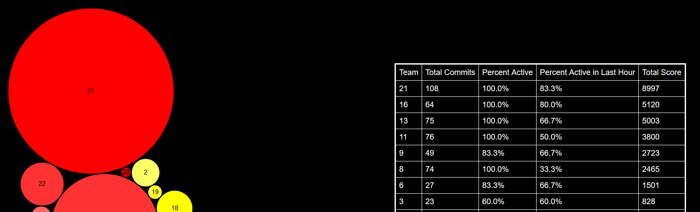
Our Accreditations and awards
21

Slide 8
